Slide 1
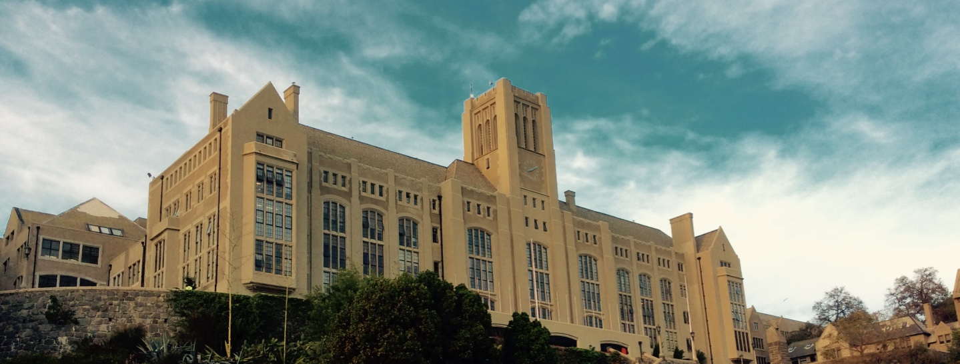

World Pendulum Alliance
Universidad Técnica Federico Santa María
Physics Department

Slide 2
World Pendulum Alliance
An e-lab global distributed remote controlled experiment to contribut for the mapping of Earth’s local gravity

Slide 3
Some experiments related to Earth’s geophysics characteristics need a global distributed data acquisition, specially those depending on geographic factors such as latitude. The World Pendulum Alliance is a federated initiative of several universities to create a network of “latitude providers” to allow the mapping of local gravity across the globe. In parallel, a dissemination project encompasses training initiatives to educate local agents in view of physics teaching. The experiment is already in production at e-lab, in Instituto Superior Técnico – Universidade de Lisboa, and the reproduction of 20 main experiments and 120 satellite experiments is foreseen in the next two years.

Slide 4
Universidad Técnica Federico Santa María
Its main campus is located in Valparaíso.
Other campuses in Santiago de Chile (Vitacura and San Joaquín).
Two other locations: one in Viña del Mar and another in Concepción.

Slide 5
Team expertise USM
Karol Trautmann Thomas
Director International Affairs Office
Hayk Hakobyan
Ph.D. Physics, Yerevan State University
Auxiliary Professor
Alfredo Navarro Lisboa
Physics Professor
Vivian Gatica Beckers
Internationalization Assistant
Claudio Dib Venturelli
Ph.D. Physics, Stanford University
Director Physical Department

Slide 6
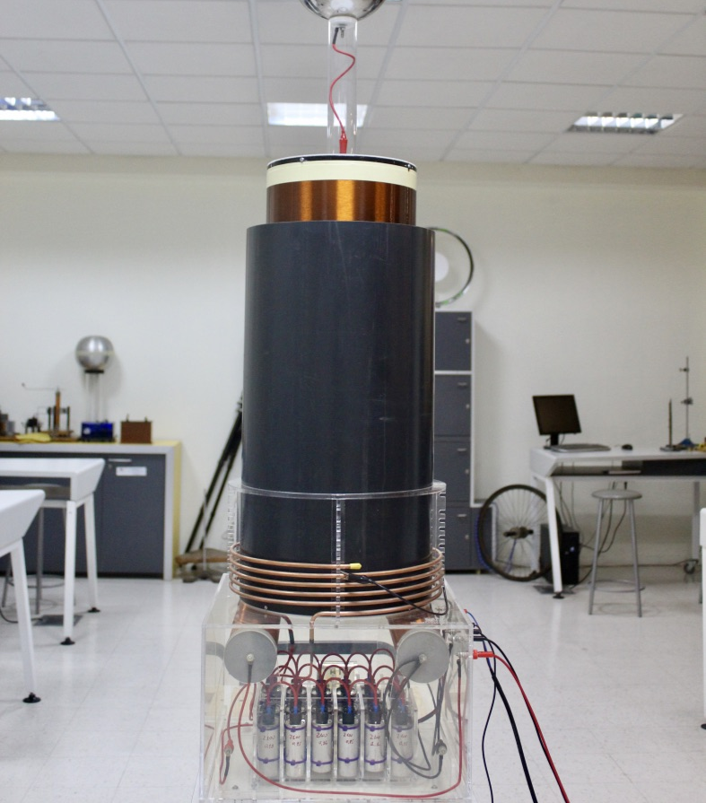
Laboratory of design and manufacture of equipment for teaching physics
USM a university with extensive experience in contemporary education methodologies.
To date, more than 30 experimental prototypes have been manufactured to promote the learning of physics.

Slide 7
This project intends to improve the quality of higher education, in the fields of mathematics, sciences and technology, by deploying a global network of remote experiments establishing the first global scientific remote experiment: the World Pendulum Alliance (WPA), a network enabling teachers and students to collect experimental data in real time at a planetary scale and measuring one (or more) of earth’s physical characteristics on their own: the variation of gravity with latitude.
This experiment is a clear demonstration of Remote Controlled Laboratories (RCL) paradigm by allowing the access to experiments which are impossible to perform in a local given laboratory. The effort in RCLs should focus in first instance on the deployment of such class of specialized apparatus for unusual experiments, generally not conducted in high schools neither on the university’s first’s years due to its specificity.

Slide 8

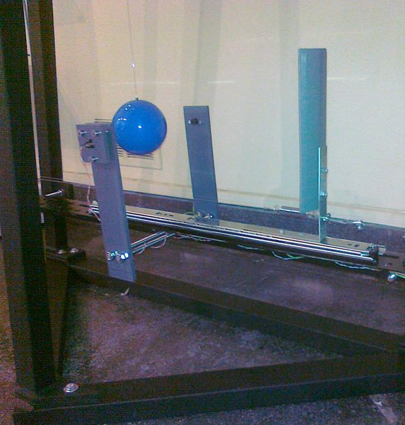
The World Pendulum
The design and construction of this complementary constellation of more than one hundred pendulums is based on previous experiments already in production on e-lab [5]. Major differences consist only on wall-assembly fixtures for the secondary pendulums associated to a given university and normally disposed on secondary schools or science centers

Slide 9
Educational oportunities
The pendulum as a gateway for advanced physics
Most students and teachers miss the complexity offered by the pendulum by using overly simple setups that do not allow for precise enough measurements that showcase the richness of the pendulum system. By using pendulums designed to allow for precise enough measurements, such as the model implemented in e-lab, users would be exposed to several advanced concepts that could serve as gateway for more advanced topics in physics and science in general. Furthermore, by being exposed to a real experimental setup in which precise measurements are being done, students are confronted with important concepts such as uncertainty, precision and experimental error.

Slide 10
Experiments supported by the setup include:
Basic pendulum experiment: Checking the period of oscillation for specific setup used and using pendulum equations to determine local gravity
Energetic balances and oscillation dampening: By studying the variation of the amplitude of oscillations in time, its possible to study how the oscillations are being damped and how much energy is being lost to drag per oscillation. Furthermore, its also possible to study how the wire torsion affects the system and include these calculations in the energy balance.
Tidal study: By running the experiment at least once per day on a period spanning several months, it’s possible to verify the small effect the moon’s tidal forces have on local gravity.

Slide 11
By combining the use of experimental setups judiciously spread around the world, its possible to study the following:
Variation of local gravity with latitude: By verifying how the period of similar pendulums varies with latitude, it’s possible to study how the Earth’s shape influences local gravity. This is already possible on the existing e-lab pendulum network.
Variation of the pendulum period with length: By using pendulums with different lengths placed at the same latitude, it’s possible to study how the period varies with pendulum length.
Variation of the pendulum period with altitude: By using similar pendulums placed at similar latitudes and vastly different altitudes (top of a mountain and by the seaside), it’s possible to study how local gravity varies with altitude.

Slide 12
The information contained in this section of the website was extracted from the article:
World Pendulum Alliance
An e-lab global distributed remote controlled experiment to contribut for the mapping of Earth’s local gravity

